Slide 1
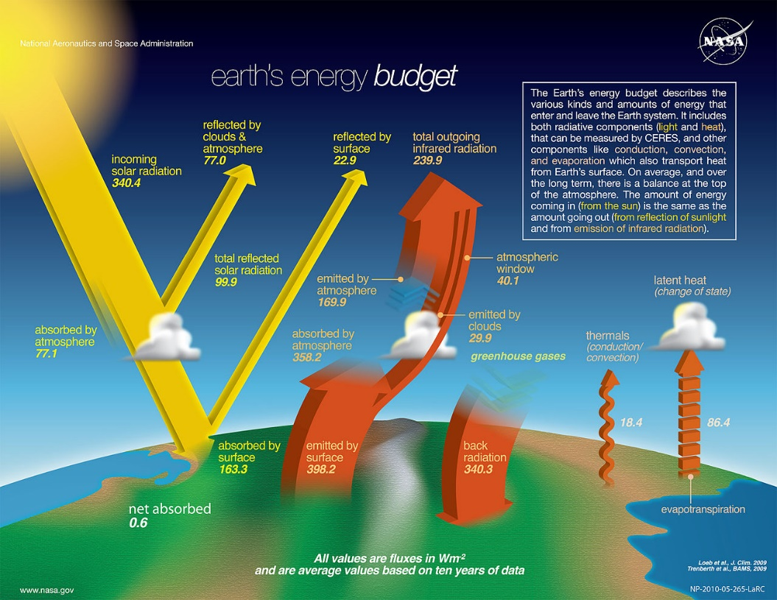
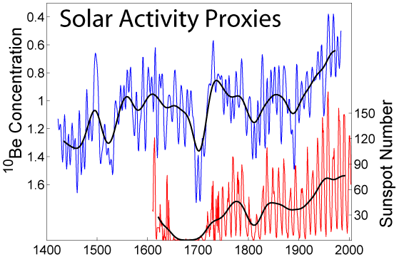
(Prokaryotes, 2014, Public Domain)
(Merikanto~commonswiki, 2006, CC BY-SA 3.0)
Climate change occurs when changes in Earth's climate system result in new weather patterns that last for at least a few decades, and maybe for millions of years. The climate system comprises five interacting parts, the atmosphere (air), hydrosphere (water), cryosphere (ice and permafrost), biosphere (living things), and lithosphere (earth's crust and upper mantle (Wikipedia, 2019)

